Slide 1

Welcome to Navigating Your Future

Slide 2
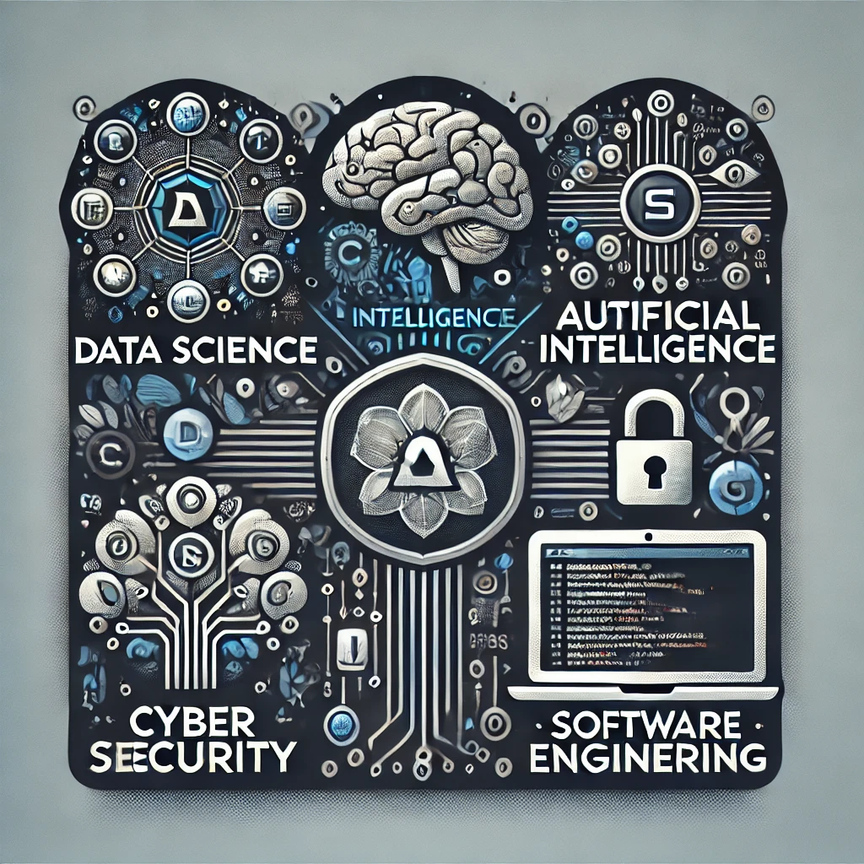
D: Data Science
A :Artificial intelligence
C: Cyber Security
S:Software Engineering

Slide 3
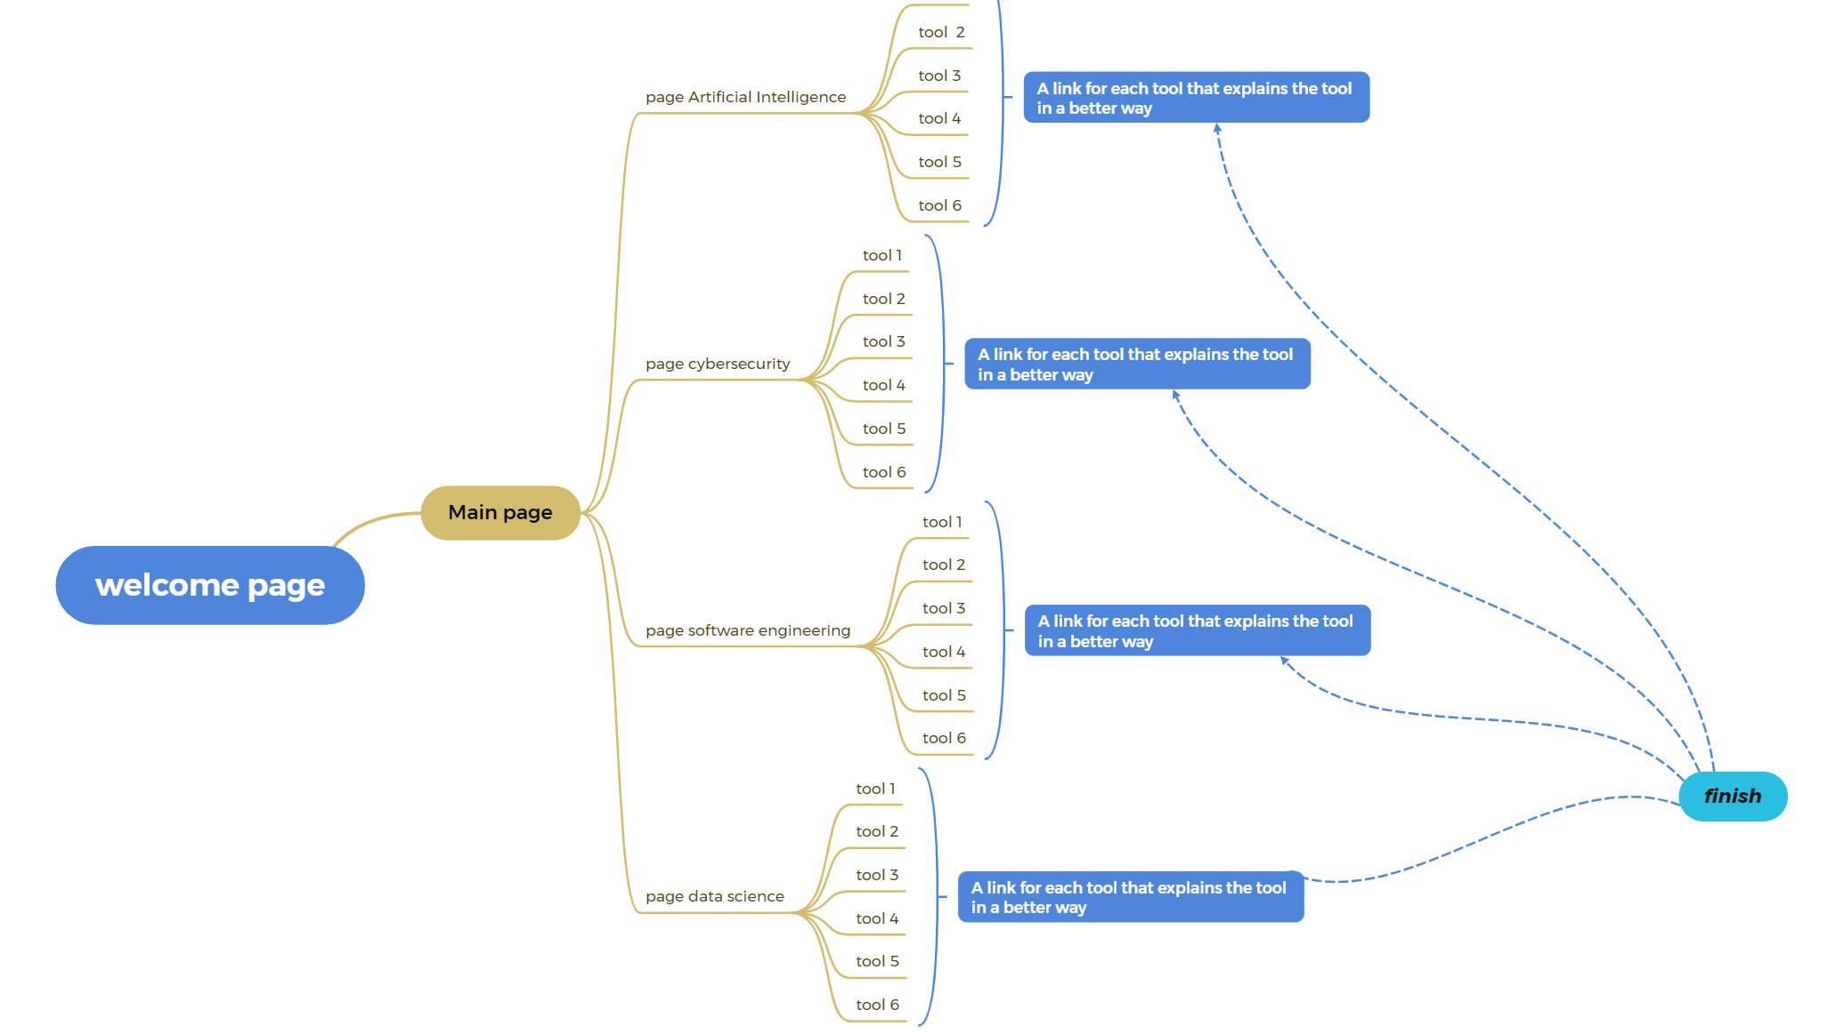

Slide 4

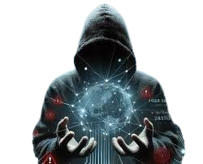

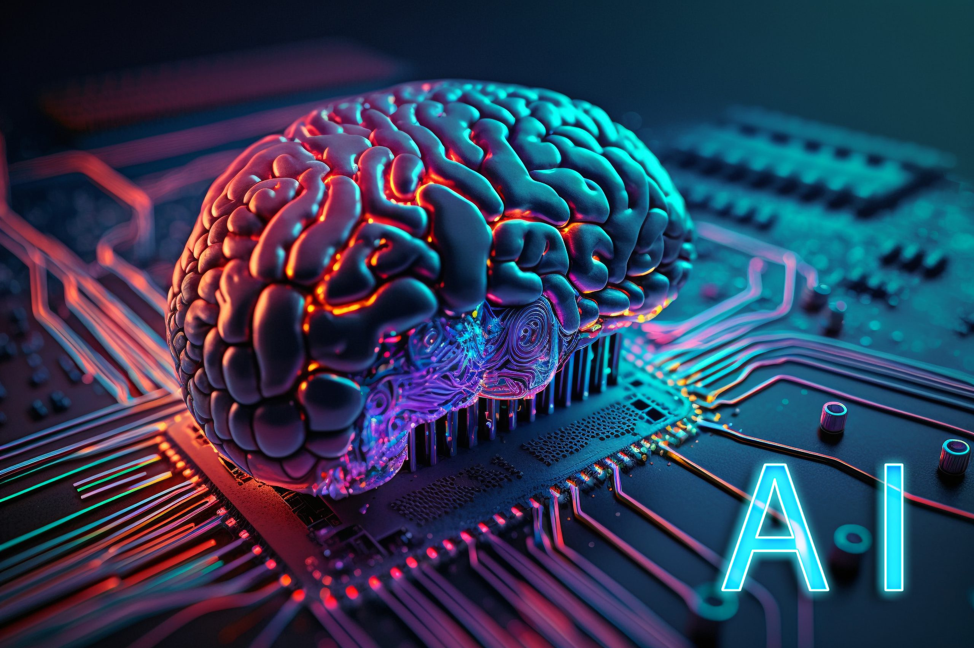

MAJORS

Slide 5

Data science
Data science helps us understand information. It uses math and computers to find patterns and guess what might happen next. This helps people make good choices. It's a fun job for people who like to solve puzzles with information

Slide 6
Artificial intelligence
Artificial Intelligence (AI) is the science of creating machines and systems capable of performing tasks that require human intelligence, such as learning, and decision-making. It powers technologies like virtual assistants, self-driving cars

Slide 7
Cyber Security
Cybersecurity is protecting computers, networks, and data from hackers and online threats to keep information safe and private.

Slide 8

Software Engineering
Software engineering is the process of designing, developing, testing, and maintaining software systems to meet specific user needs.

Slide 9
DACS thank you for listening to us
The developers are with you until you know your way around

